Slide 1
Survey Plot

Slide 2
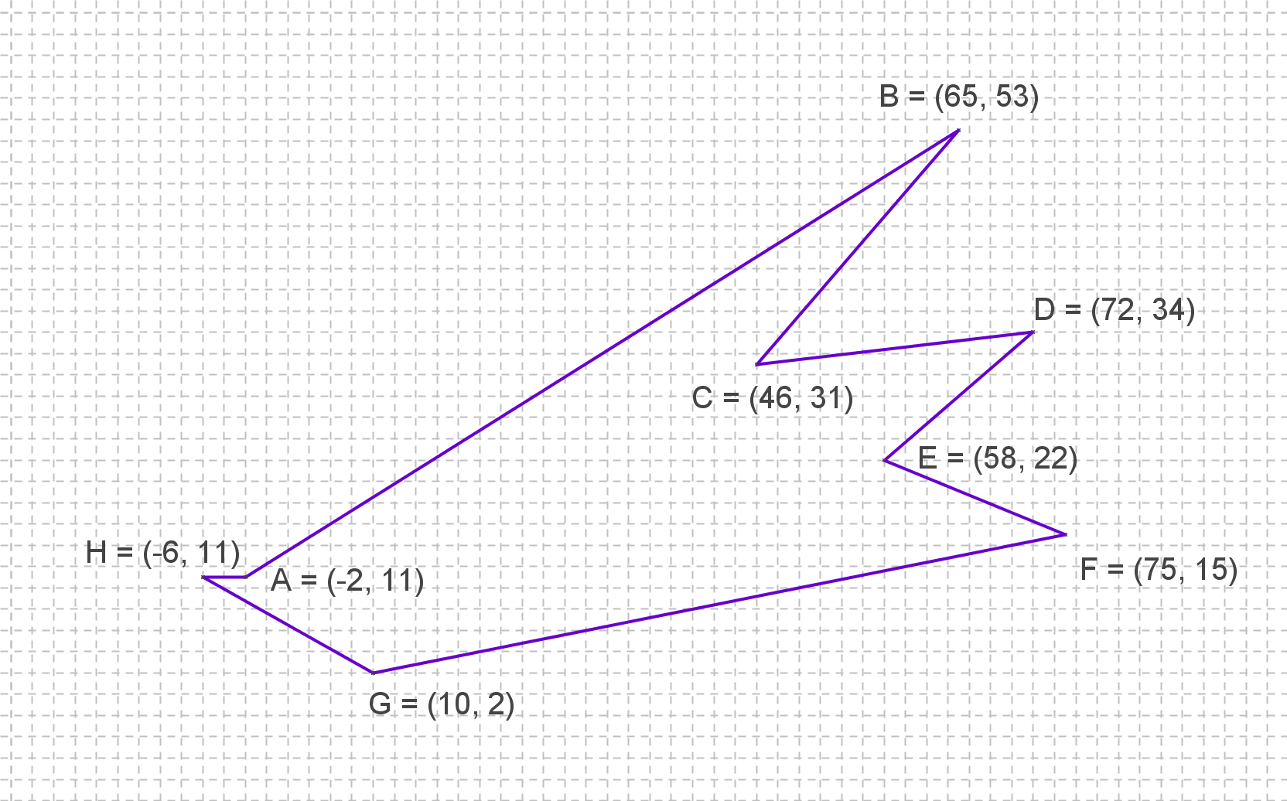
Survey Plot
Find the exact area of the polygon.
L
Area = sq. units

Slide 3





$$y$$
$$\left(x_{2},y_{2}\right)$$
What’s the area of this triangle?
$$\left(x_{3},y_{3}\right)$$
$$\left(x_{1},y_{1}\right)$$
$$x$$

Slide 4




$$y$$
$$\left(x_{2},y_{2}\right)$$
What’s the area of this triangle?
$$\left(x_{3},y_{3}\right)$$
$$\left(x_{1},y_{1}\right)$$
$$x$$
$$\left(x_{1},0 \right)$$
$$\left(x_{2},0 \right)$$
$$\left(x_{3},0 \right)$$

Slide 5



$$\frac{1}{2}\left(y_{2}+y_{1}\right)\left(x_{2}−x_{1}\right)$$
$$\frac{1}{2}\left(y_{3}+y_{2}\right)\left(x_{3}−x_{2}\right)$$
$$\frac{1}{2}\left(y_{3}+y_{1}\right)\left(x_{3}−x_{1}\right)$$

Slide 6

$$\frac{1}{2}\left(y_{2}+y_{1}\right)\left(x_{2}−x_{1}\right)$$
$$\frac{1}{2}\left(y_{3}+y_{2}\right)\left(x_{3}−x_{2}\right)$$
$$\frac{1}{2}\left(y_{3}+y_{1}\right)\left(x_{1}−x_{3}\right)$$

Slide 7

$$y$$
This process works with ANY polygon, not just a triangle.
And it doesn’t have to be convex either!
$$x$$

Slide 8
This process works with ANY polygon, not just a triangle.
And it doesn’t have to be convex either!

Slide 9
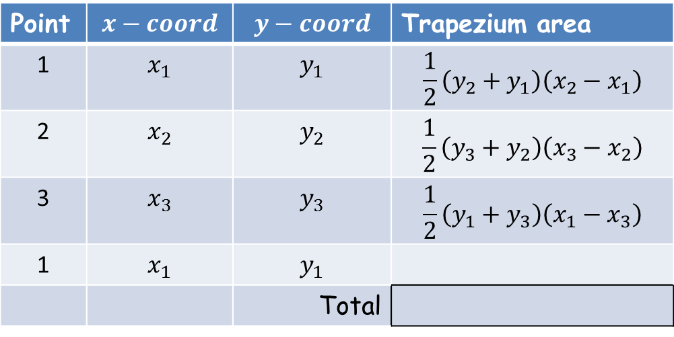
So, list the co-ordinates in columns in a spreadsheet, repeating the first co-ordinates at the end.
Then enter a formula for the area of the trapezium formed by the first pair of co-ordinates.
Copy down this formula to the last point (point 3).
Finally, sum the areas of the trapezium.
Point | $$x−coord$$ | $$y−coord$$ | Trapezium area
1 | $$x_{1}$$ | $$y_{1}$$ | $$\frac{1}{2}\left(y_{2}+y_{1}\right)\left(x_{2}−x_{1}\right)$$
2 | $$x_{2}$$ | $$y_{2}$$ | $$\frac{1}{2}\left(y_{3}+y_{2}\right)\left(x_{3}−x_{2}\right)$$
3 | $$x_{3}$$ | $$y_{3}$$ | $$\frac{1}{2}\left(y_{1}+y_{3}\right)\left(x_{1}−x_{3}\right)$$
1 | $$x_{1}$$ | $$y_{1}$$
 |  | Total

Slide 10
So, list the co-ordinates in columns in a spreadsheet, repeating the first co-ordinates at the end.
Then enter a formula for the area of the trapezium formed by the first pair of co-ordinates.
Copy down this formula to the last point (point 3).
Finally, sum the areas of the trapezium.
Point | $$x−coord$$ | $$y−coord$$ | Trapezium area
1 | $$x_{1}$$ | $$y_{1}$$ | $$\frac{1}{2}\left(y_{2}+y_{1}\right)\left(x_{2}−x_{1}\right)$$
2 | $$x_{2}$$ | $$y_{2}$$ | $$\frac{1}{2}\left(y_{3}+y_{2}\right)\left(x_{3}−x_{2}\right)$$
3 | $$x_{3}$$ | $$y_{3}$$ | $$\frac{1}{2}\left(y_{1}+y_{3}\right)\left(x_{1}−x_{3}\right)$$
1 | $$x_{1}$$ | $$y_{1}$$
 |  | Total

Slide 11
So, list the co-ordinates in columns in a spreadsheet, repeating the first co-ordinates at the end.
Then enter a formula for the area of the trapezium formed by the first pair of co-ordinates.
Copy down this formula to the last point (point 3).
Finally, sum the areas of the trapezium.
Point | $$x−coord$$ | $$y−coord$$ | Trapezium area
1 | $$x_{1}$$ | $$y_{1}$$ | $$\frac{1}{2}\left(y_{2}+y_{1}\right)\left(x_{2}−x_{1}\right)$$
2 | $$x_{2}$$ | $$y_{2}$$ | $$\frac{1}{2}\left(y_{3}+y_{2}\right)\left(x_{3}−x_{2}\right)$$
3 | $$x_{3}$$ | $$y_{3}$$ | $$\frac{1}{2}\left(y_{1}+y_{3}\right)\left(x_{1}−x_{3}\right)$$
1 | $$x_{1}$$ | $$y_{1}$$
 |  | Total

Slide 12
So, list the co-ordinates in columns in a spreadsheet, repeating the first co-ordinates at the end.
Then enter a formula for the area of the trapezium formed by the first pair of co-ordinates.
Copy down this formula to the last point (point 3).
Finally, sum the areas of the trapezium.
Point | $$x−coord$$ | $$y−coord$$ | Trapezium area
1 | $$x_{1}$$ | $$y_{1}$$ | $$\frac{1}{2}\left(y_{2}+y_{1}\right)\left(x_{2}−x_{1}\right)$$
2 | $$x_{2}$$ | $$y_{2}$$ | $$\frac{1}{2}\left(y_{3}+y_{2}\right)\left(x_{3}−x_{2}\right)$$
3 | $$x_{3}$$ | $$y_{3}$$ | $$\frac{1}{2}\left(y_{1}+y_{3}\right)\left(x_{1}−x_{3}\right)$$
1 | $$x_{1}$$ | $$y_{1}$$
 |  | Total
Think of this point as point 4 in the list.
This process works with ANY polygon, not just a triangle.

Slide 13
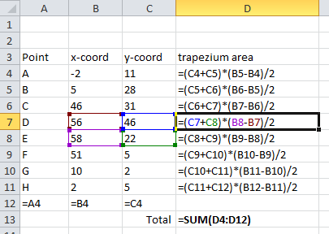
An example of what your spreadsheet could look like

Slide 14
What if the polygon had a hole in it?
So to include a hole insert its co-ordinates into the existing list taking care to repeat connecting points (i.e. J and K) and avoid crossing over previous lines.
F
D
G
C
E
hole
N
H
B
R
L
A
I
O
K
Q
J
P
M
S

Slide 15
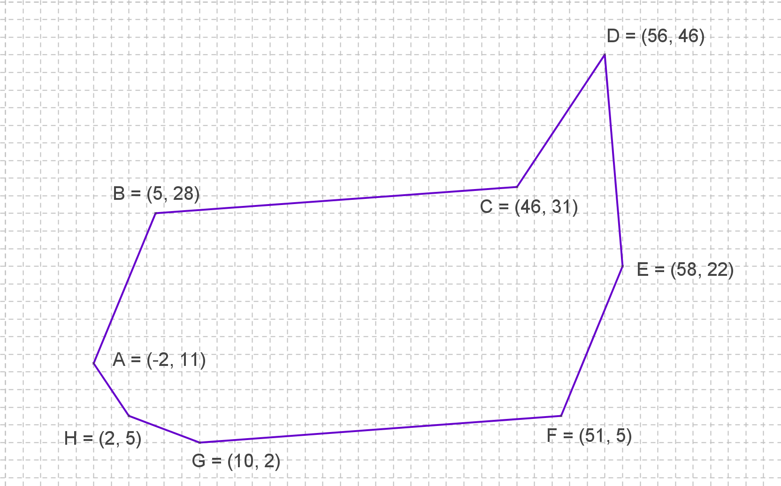
You should all get the same answer: 1501 unit²
How was this achieved?
A

Slide 16
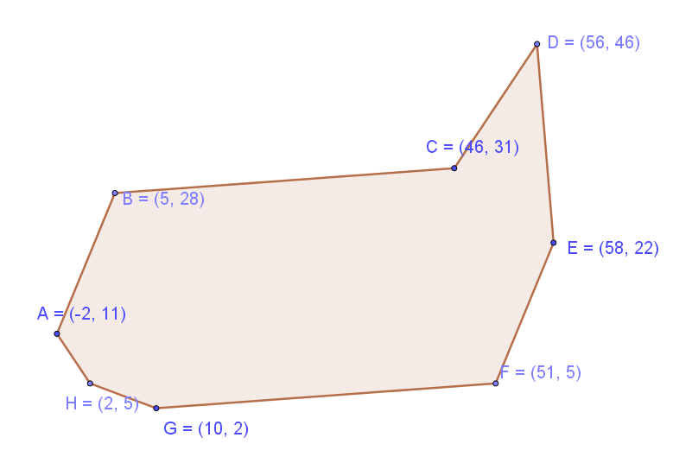
You should all get the same answer: 1501 unit²
How was this achieved?
The position of A, C, E and G is the same on all worksheets.

Slide 17
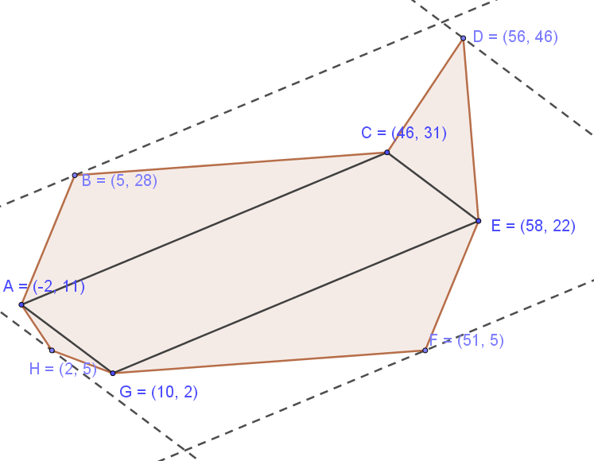











You should all get the same answer: 1501 unit²
How was this achieved?
Perpendicular heights of triangles
The position of A, C, E and G is the same on all worksheets.
The points form a parallelogram (although the shape is irrelevant).
All triangles with a side of ACEG as a base share the same height (and so the same area).
Areas and lengths
are shown.
$$13$$
$$135$$
$$18$$
$$15$$
$$338$$
$$52$$
$$672$$
$$338$$
$$18$$
$$13$$
$\frac{12}{5}$

Slide 18
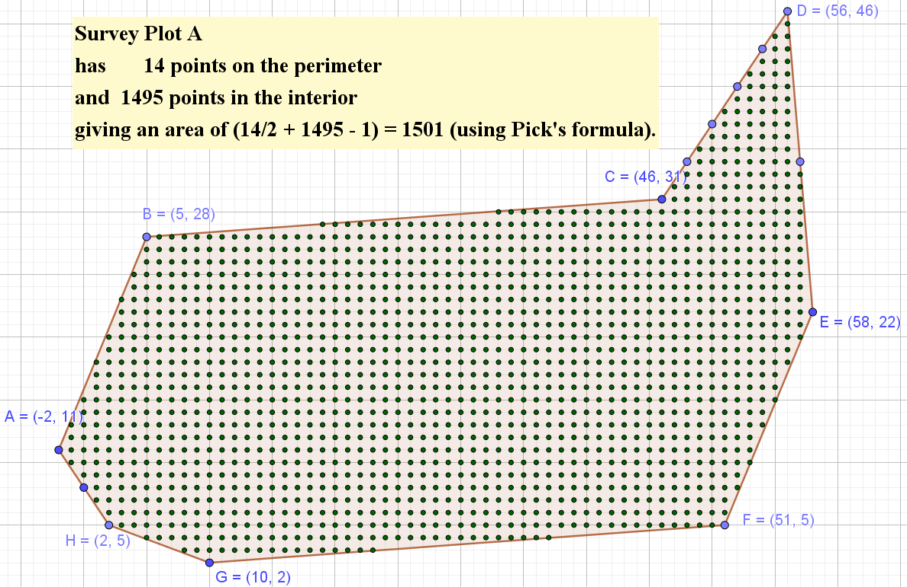
Given that the vertices lie on a grid you could have used Pick’s Theorem!

Slide 20
Note to Teacher - 1
It is useful to get the pupils to insert a chart of their survey plot.
  Just highlight the coordinates
  Insert scatter chart (with points joined by straight lines)
  They should now see a representation of their worksheeet.
Use the Geogebra file to explain how the polygons were constructed. Press the buttons, it is all self-explanatory, I hope.

Slide 21
Note to Teacher - 2
If a pupil gets a close, but incorrect answer it is probably due to copying down the formula by one cell too many. The last coordinates (the same as the first coordinates) should have no formula next to it.

Slide 22
RESOURCES

Slide 23
SIC_28
Survey Plot
Find the exact area of the polygon.
A
Area = sq. units

Slide 24
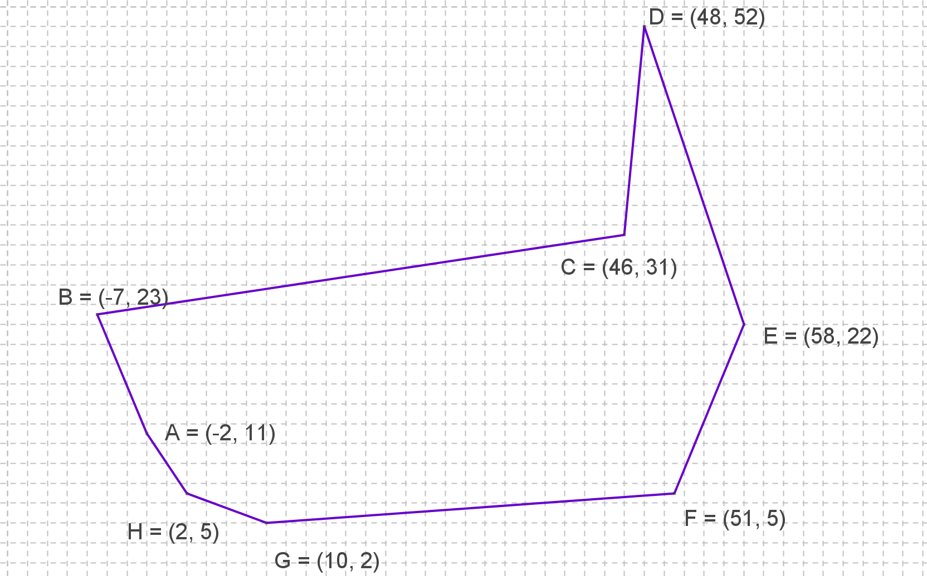
SIC_28
Survey Plot
Find the exact area of the polygon.
B
Area = sq. units

Slide 25
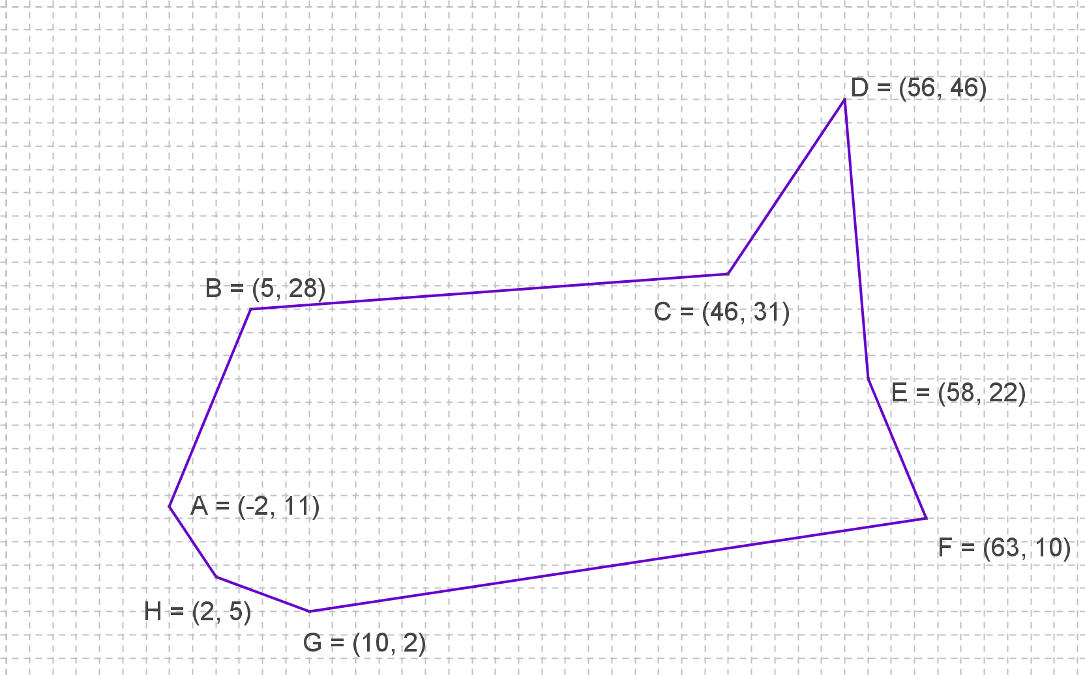
SIC_28
Survey Plot
Find the exact area of the polygon.
C
Area = sq. units

Slide 26
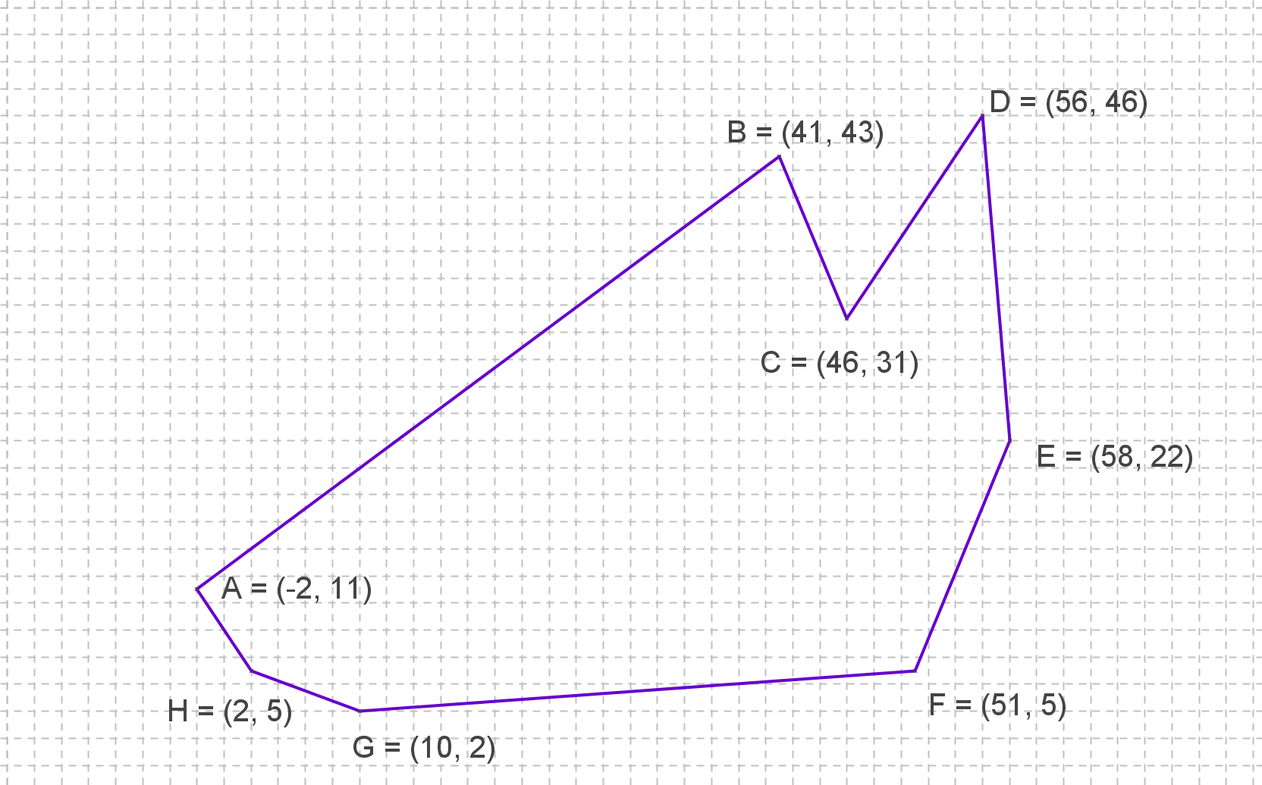
SIC_28
Survey Plot
Find the exact area of the polygon.
D
Area = sq. units

Slide 27
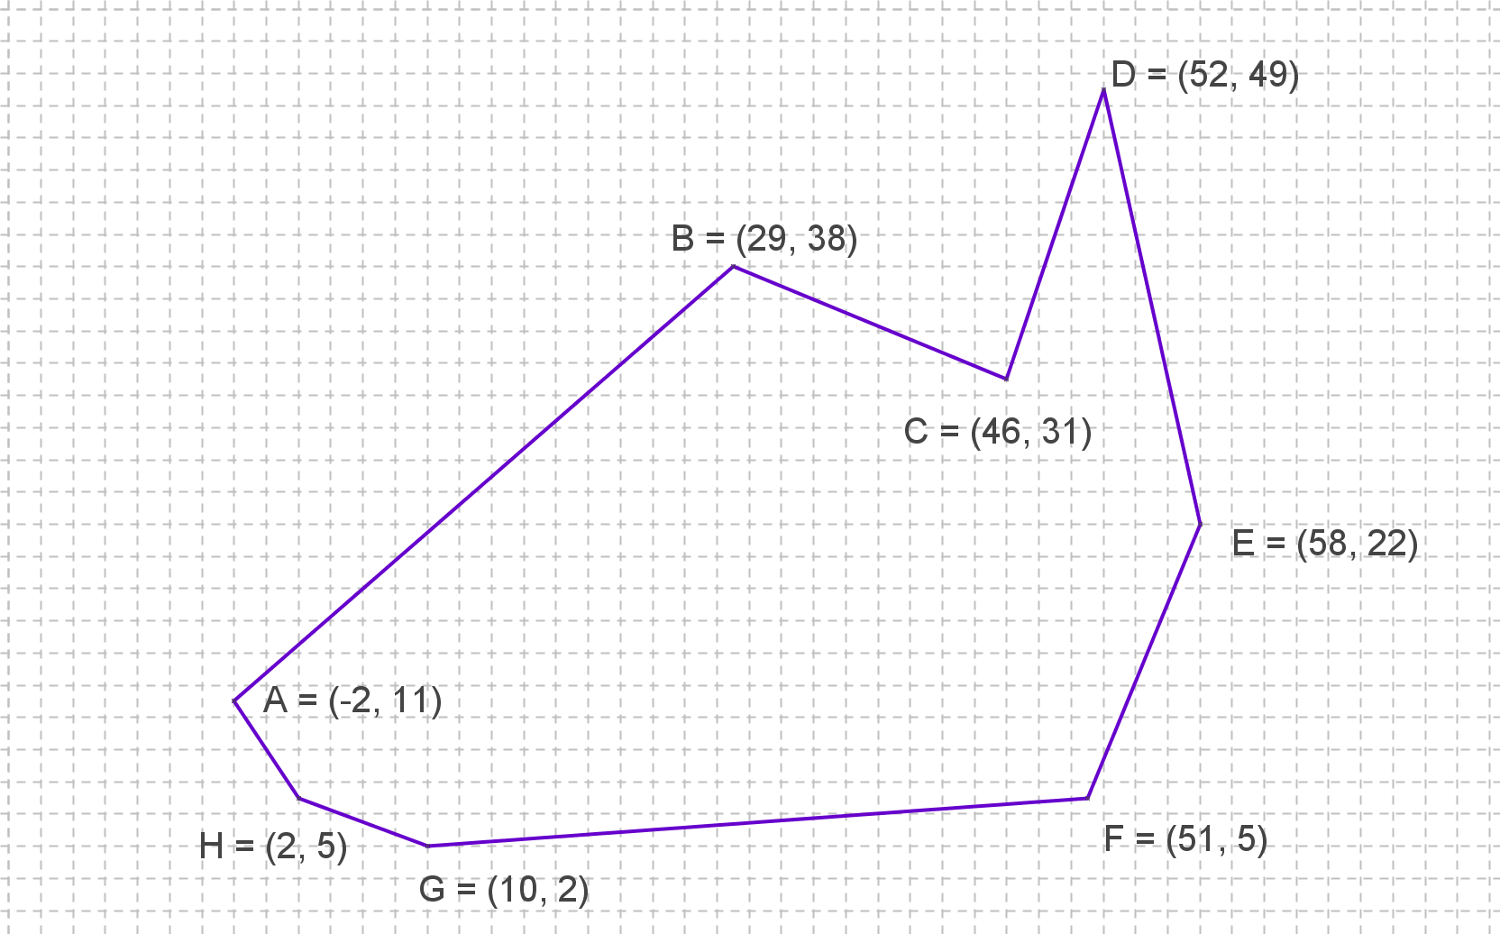
SIC_28
Survey Plot
Find the exact area of the polygon.
E
Area = sq. units

Slide 28
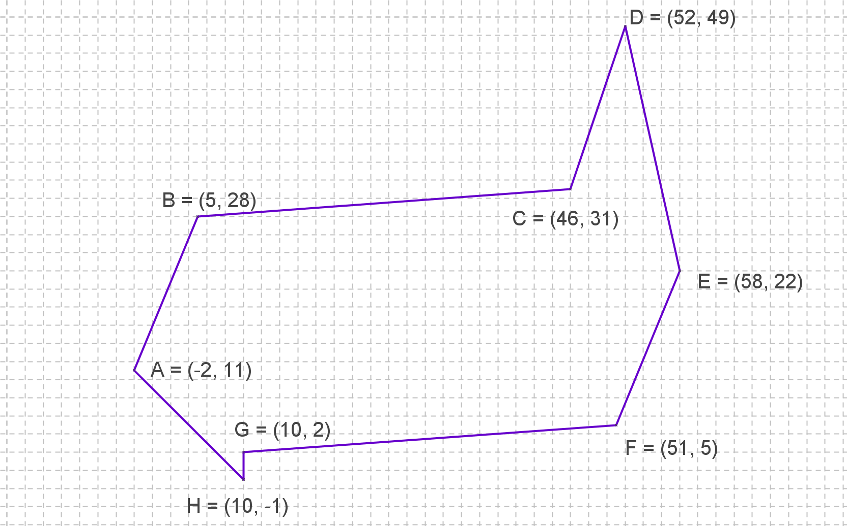
SIC_28
Survey Plot
Find the exact area of the polygon.
F
Area = sq. units

Slide 29
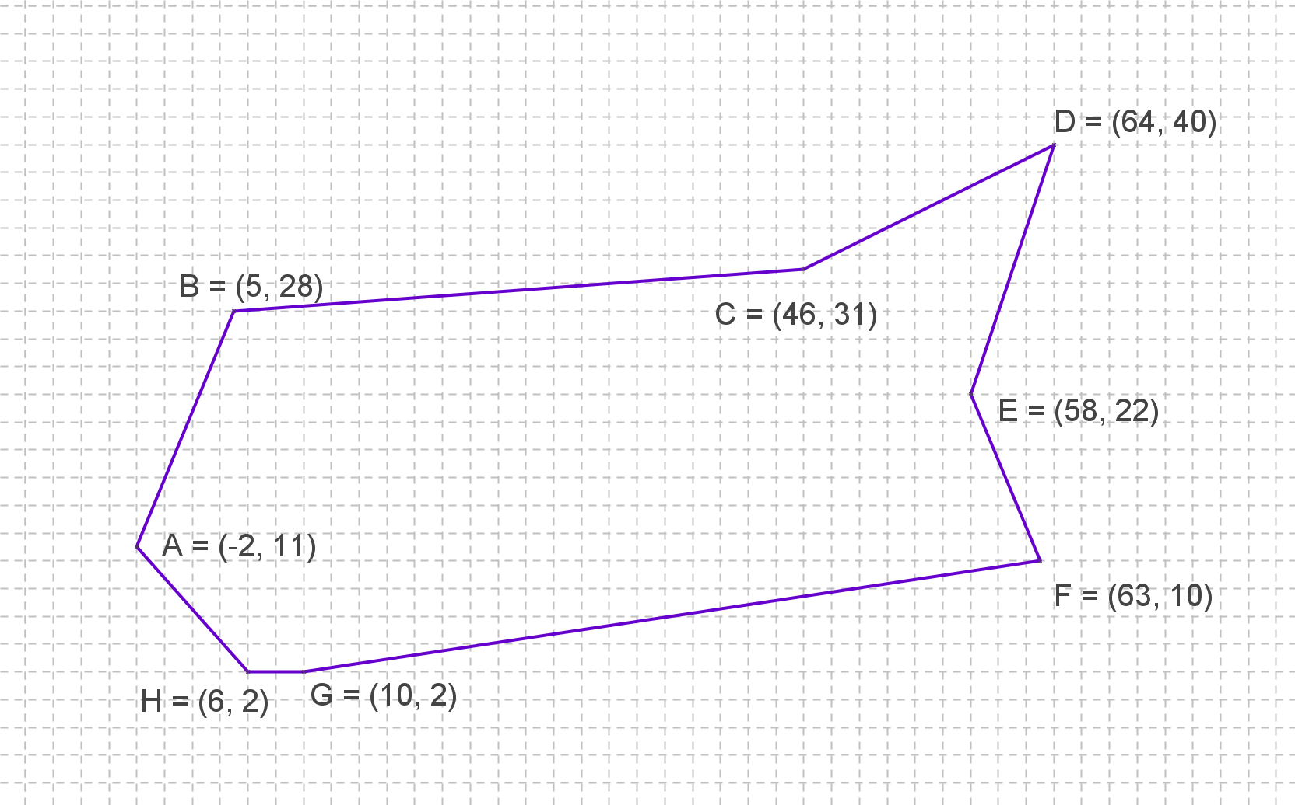
SIC_28
Survey Plot
Find the exact area of the polygon.
G
Area = sq. units

Slide 30
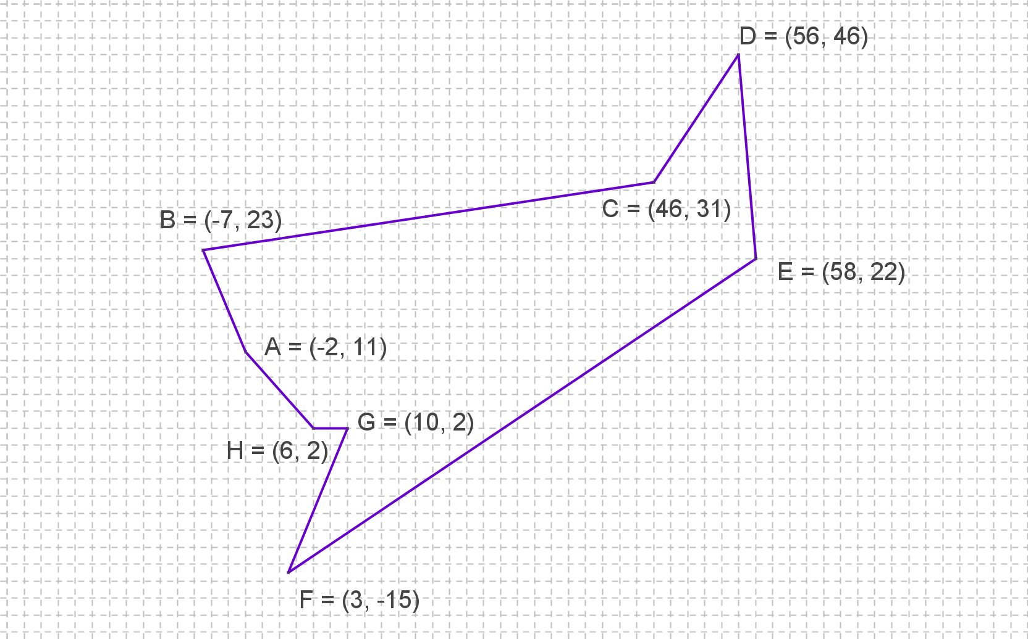
SIC_28
Survey Plot
Find the exact area of the polygon.
H
Area = sq. units

Slide 31
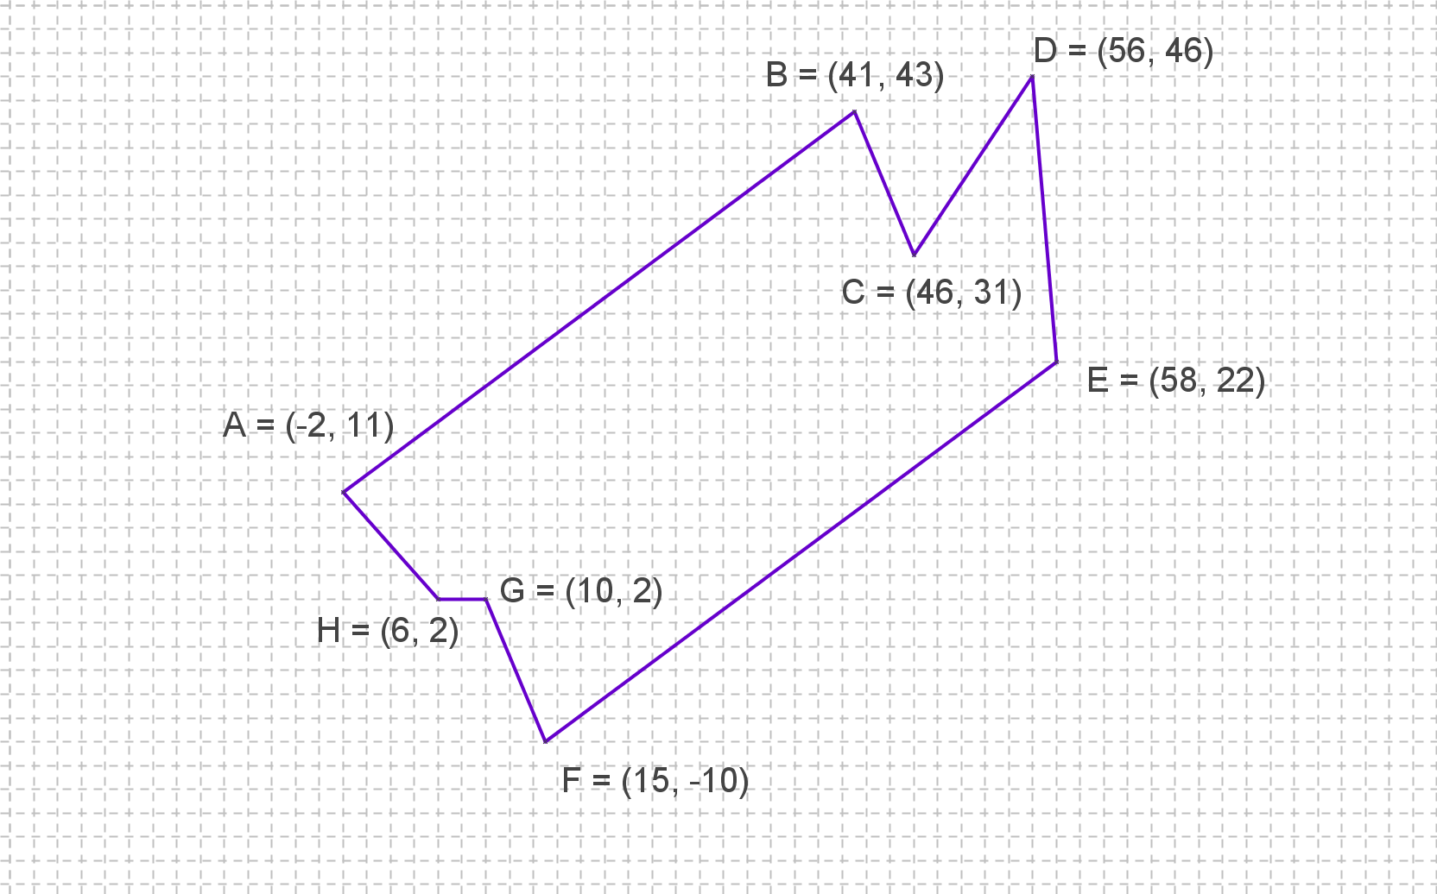
SIC_28
Survey Plot
Find the exact area of the polygon.
I
Area = sq. units

Slide 32
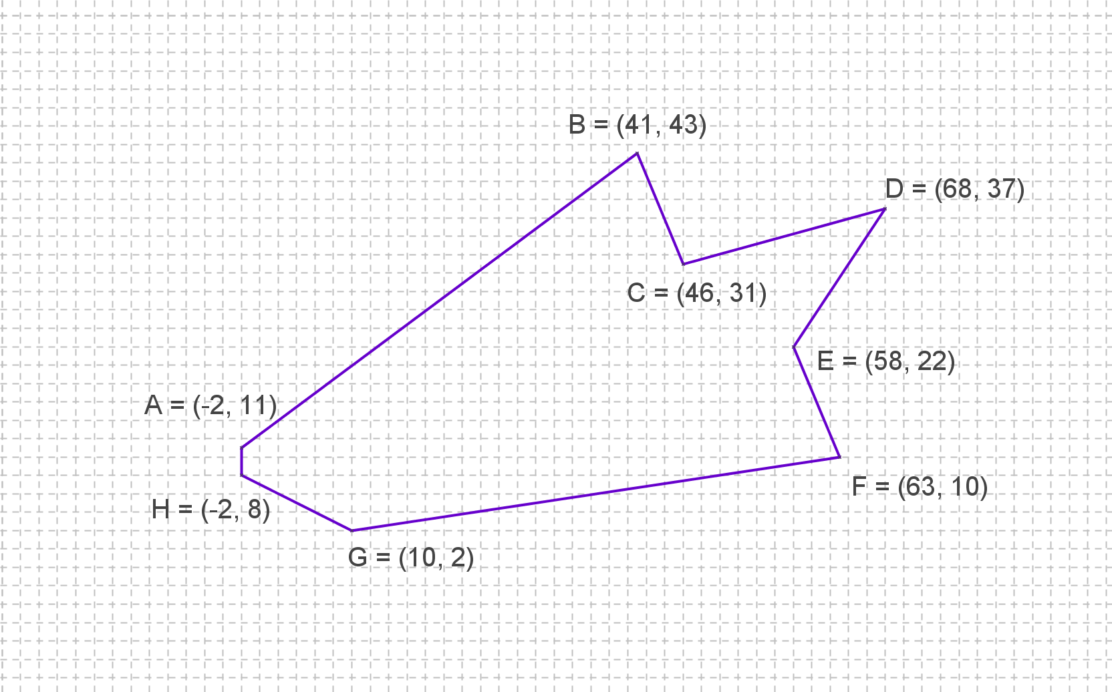
SIC_28
Survey Plot
Find the exact area of the polygon.
J
Area = sq. units

Slide 33
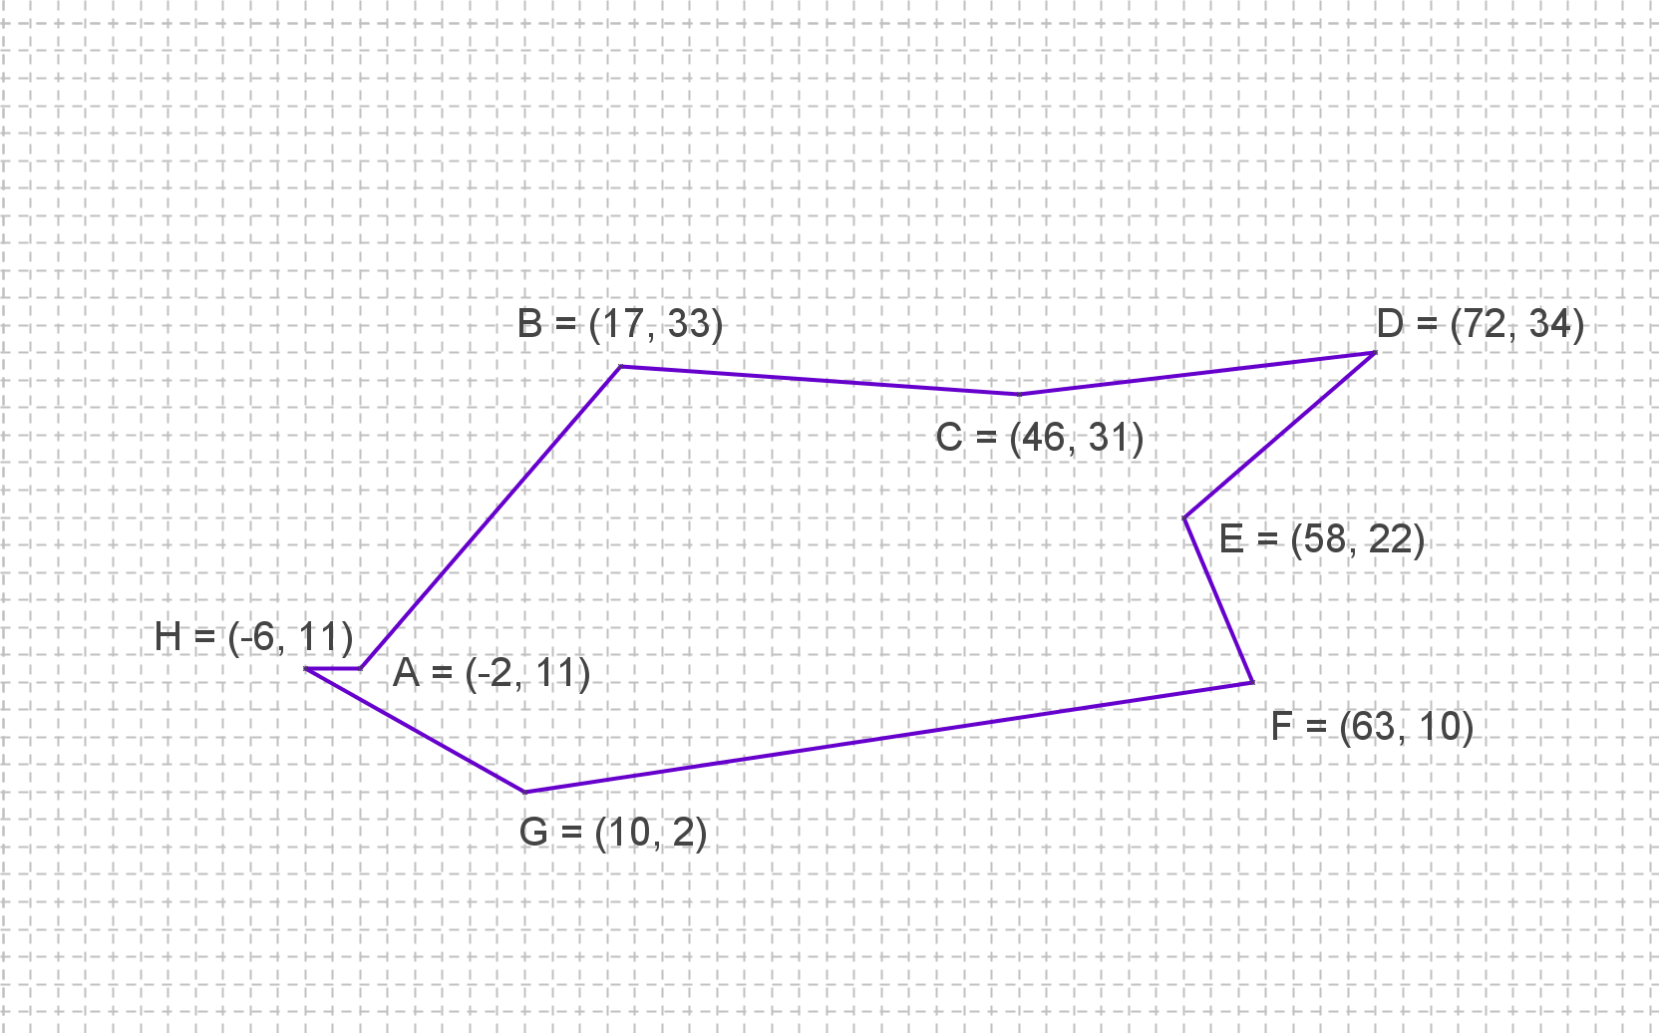
SIC_28
Survey Plot
Find the exact area of the polygon.
K
Area = sq. units

Slide 34
SIC_28
Survey Plot
Find the exact area of the polygon.
L
Area = sq. units

Slide 35
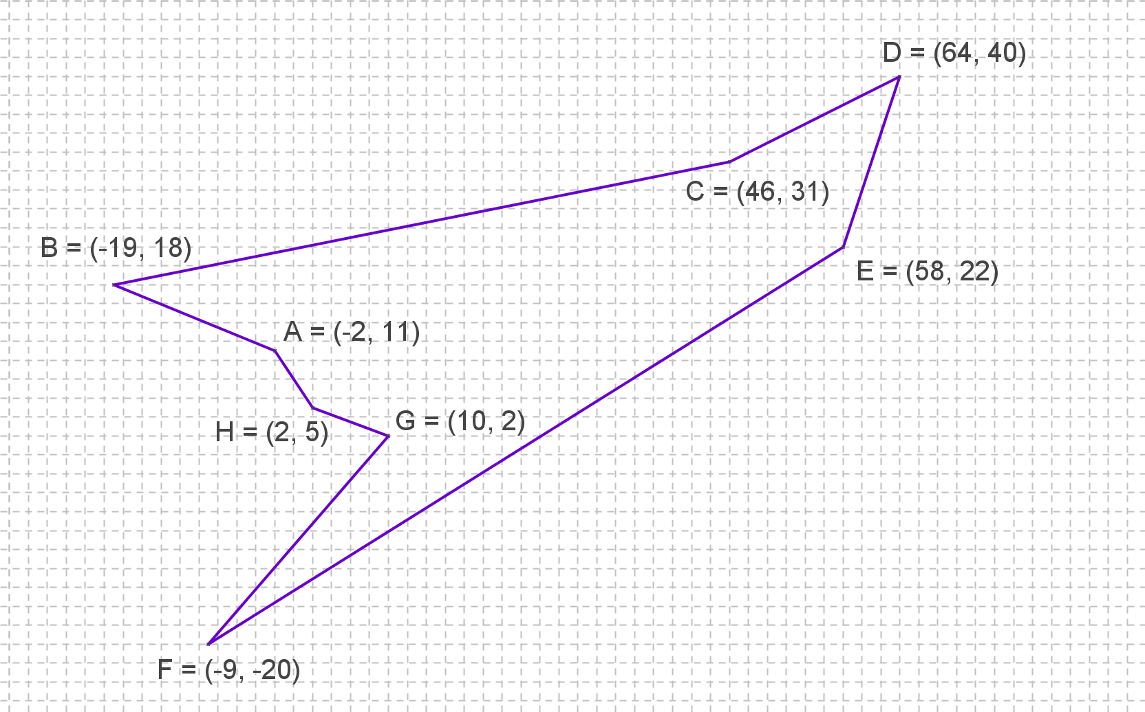
SIC_28
Survey Plot
Find the exact area of the polygon.
M
Area = sq. units

Slide 36
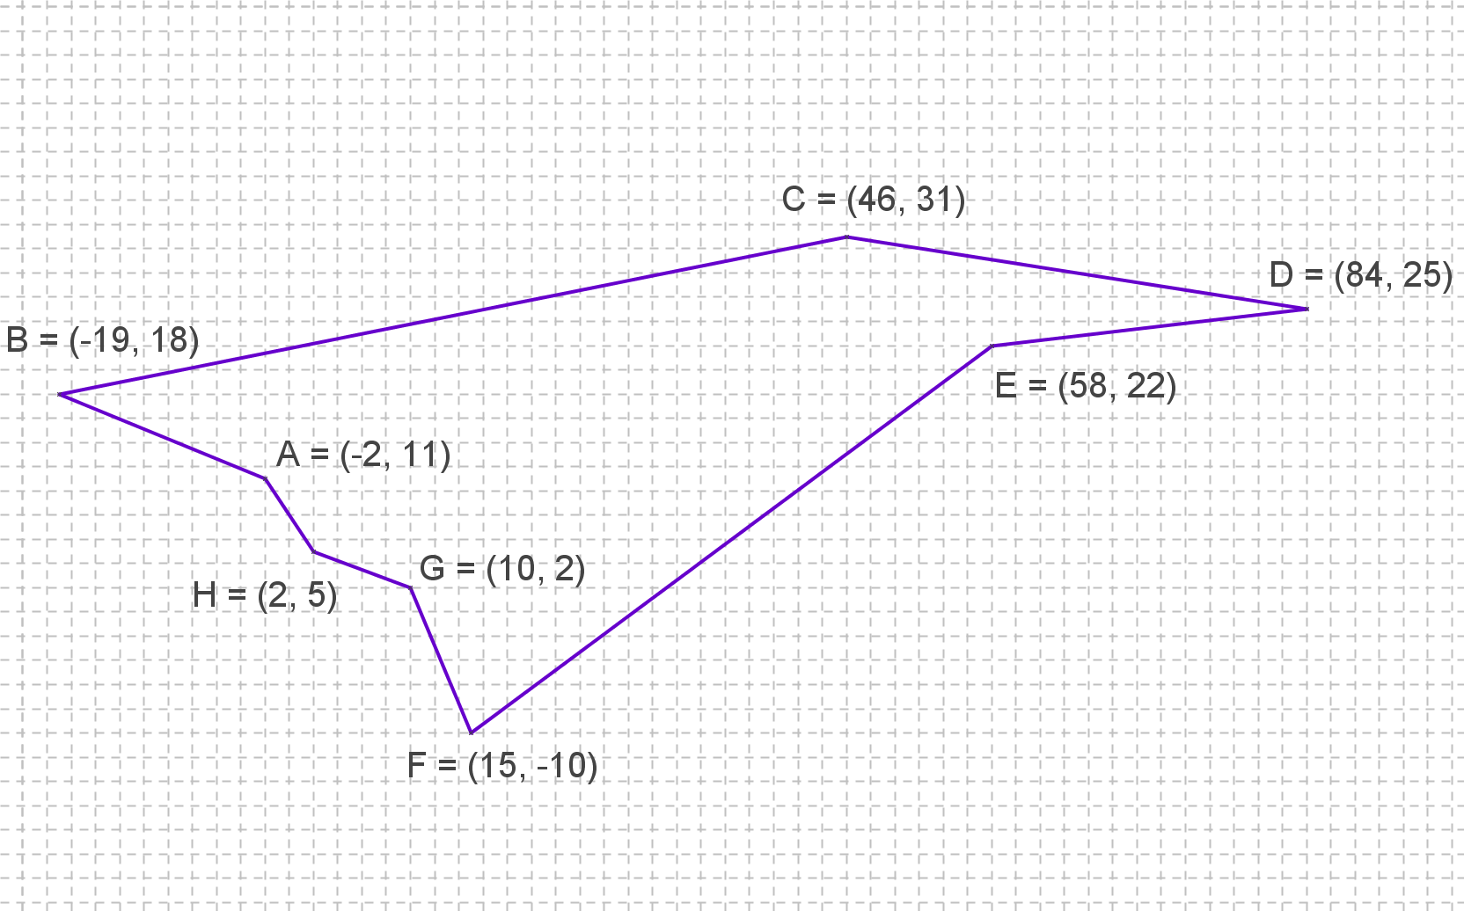
SIC_28
Survey Plot
Find the exact area of the polygon.
N
Area = sq. units

